Slide 1

From Berkeley to Beloved:
A brief history of book banning in virginia
Keith Weimer, Librarian for History and Religious Studies
University of Virginia
kw6m@virginia.edu
Notes:
NOTE:
To change the image on this slide, select the picture and delete it. Then click the Pictures icon in the placeholder to insert your own image.

Slide 2
Taking the long view
Set the current wave of challenges into longer historical context.
Place events in Virginia in the context of national trends.
Identify arguments that would-be censors have used effectively.
Historical examples of how challenges have been addressed/limited.
Not a comprehensive survey; focus on broad historical trends and modern examples where initial challenges have implicated a broader range of reading material and affected state or local politics.

Slide 3
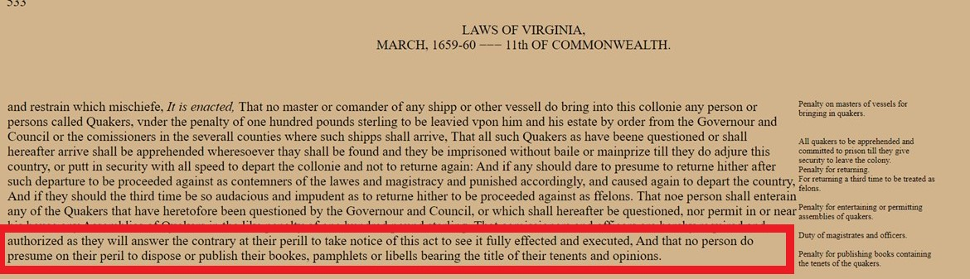
Some long term trends
“ [each] upsurge of repressiveness … reflect[s] the particular political, cultural, and technological realities of [those] years
(Paul Boyer, Purity in Print, 317).”
Race, sex, religion have been recurring themes in book bans and challenges.

Slide 4
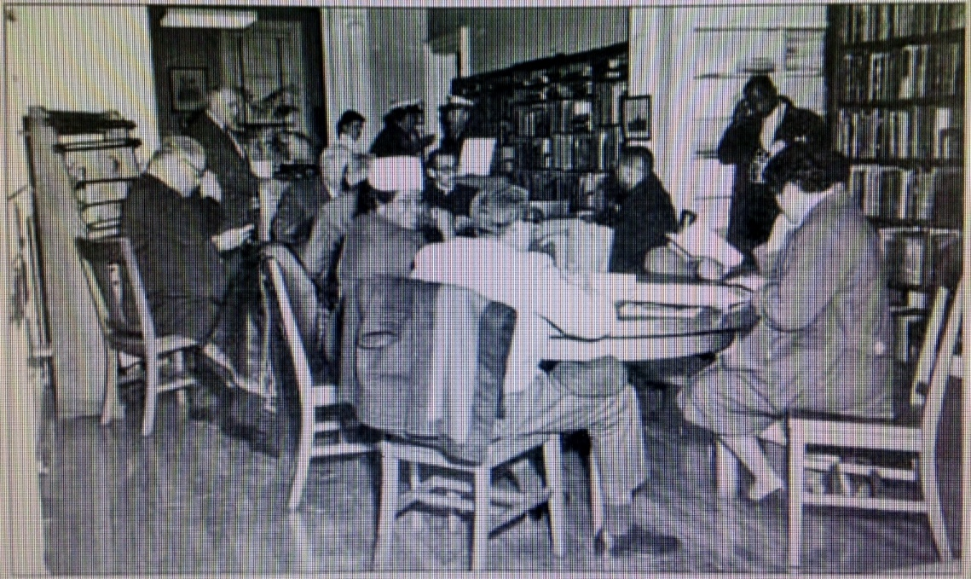
Long-Term Trends, Cont.
Separate intellectual freedom regimes for most of Virginia’s history.
Sit-in, McKenney Public Library, Petersburg, 1960

Slide 5
Some long term trends, cont.
Sense of progress, especially since 1960s (recently called into question):
  Increasing freedom of expression, diversity, attention given to marginalized voices.
  Shift from forms of state or national support for censorship to localized challenges.
  From censorship including adults to censorship focused on children.

Slide 6
1954-1973: rapid opening and change
1957 U.S. Supreme Court--Roth v. United States and Alberts v. California--shift test for “obscenity:”
“material whose ‘dominant theme taken as a whole appeals to the prurient interest’" of the "average person, applying contemporary community standards.’” (Largely reaffirmed by Miller v. California, 1973).
Movements questioning America’s role in the world, demanding sexual freedom, women’s liberation, gay liberation—becoming increasingly militant and deepening their critiques of society.
Shift from openly espousing segregation to denouncing “cultural decline” accompanying integration—especially rise in crime, urban uprisings.
Social critiques, liberation movements, find more reflection in publishing, educational curricula, and libraries.

Slide 7
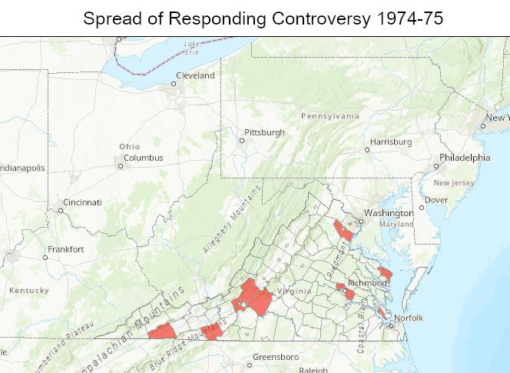
The responding Controversy and its effects: 1974-82
1972-73: Va. Dept. of Education mandates new English textbooks; greater multiculturalism. Many counties adopt the Responding Series, published by Ginn and Co.
1974-75: Controversy spreads from Washington County across the state.
April 1975: Va. Board of Education draws up a new list of textbooks, “Expects parents to have the right to review textbooks proposed for their school, orally and in writing.”
1979-80: Campaign for Creationism in Washington County schools.
1980-82: Campaign to remove Sidney Sheldon, Harold Robbins novels and other books from Washington County Public Library.
1983-?: Continued impact on education?

Slide 8
1980s: two landmark cases
1982: Board of Education, Island Trees School District v. Pico – Potentially limits discretion of school boards to remove library books. Plurality decision, supported by four justices (a fifth concurred in part):
    Board officials’ “might well defend their claim of absolute discretion in matters of curriculum by reliance upon their duty to inculcate community values. But we think that [their] reliance upon that duty is misplaced where, as here, they attempt to extend their claim of absolute discretion beyond the compulsory environment of the classroom, into the school library and the regime of voluntary inquiry that there holds sway.”
  1988: Commonwealth of Virginia v. American Booksellers Association – “serious value analysis of [a work where children are the audience] must be conducted from the upper end of a targeted group’s age range.”

Slide 9
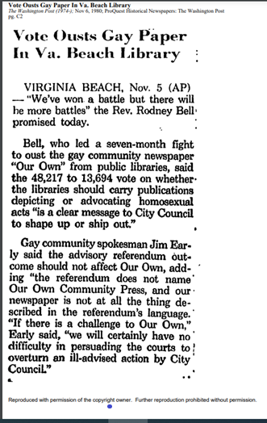
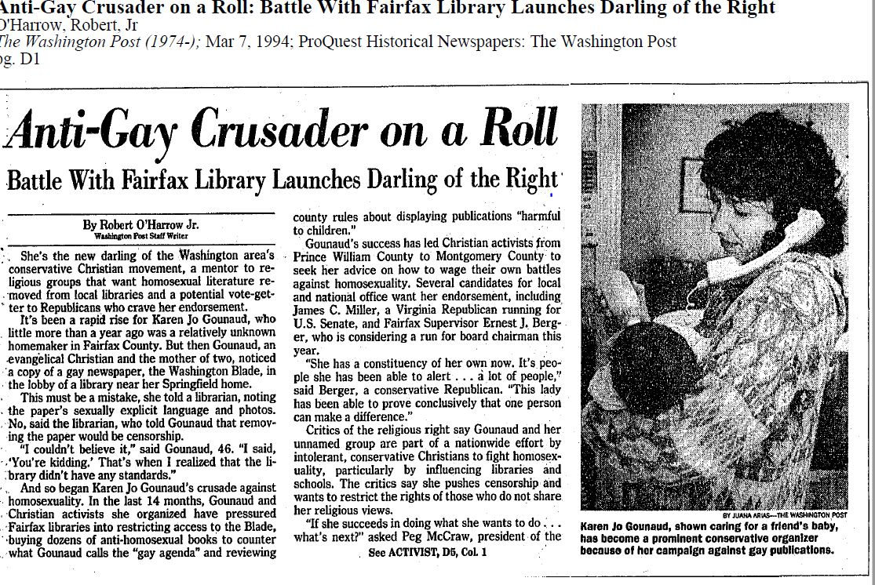
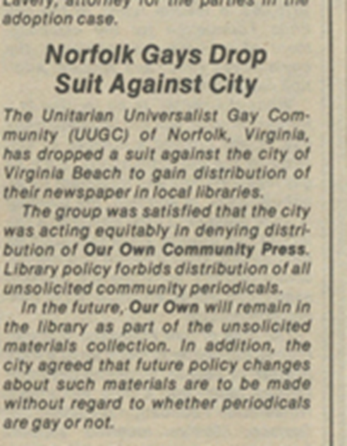
The Virginia Beach Referendum (1980) and the Fairfax Public Library Controversy (1993-1994):
Library Materials About Homosexuality
1980: Complaints about “Our Own” in Virginia Beach lead to referendum “on whether the libraries should carry publications depicting or advocating homosexual acts.”
1993-95: Complaints about “The Blade” in Fairfax County Libraries lead to demands for inclusion of titles advocating conversion therapy, restrictions on confidentiality for minors.

Slide 10
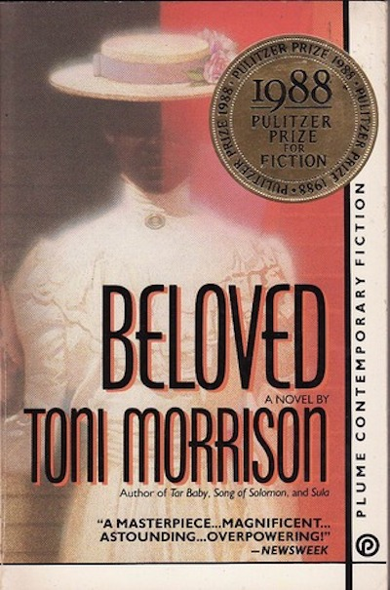
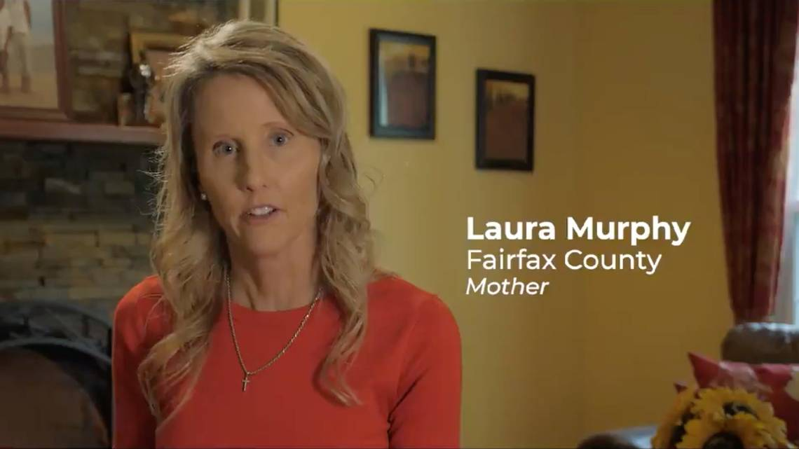
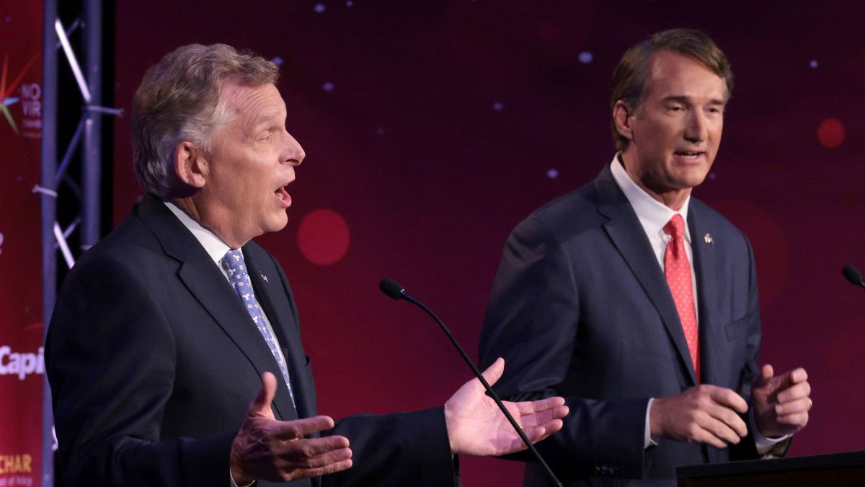
“Beloved” And parental control: 2012-2023
2012-16: Laura Murphy campaigns for legislation requiring parental notification of “sexually explicit material” in course readings. Bill passes in General Assembly; vetoed by Gov. McAuliffe.
2021: Glenn Youngkin features Murphy and veto in gubernatorial campaign. Calls for “parental control” in education.
2022: Revived version of Murphy’s bill signed into law by Youngkin, along with legislation prohibiting “divisive concepts” in public school teaching.
2023: Additional bills in General Assembly requiring school librarians to flag “sexually explicit materials:” attempting to redefine obscenity; and prohibiting colleges and universities from showing “sexually explicit content” to minors. All defeated.

Slide 11
The Normalization of Book Banning?:
2023-2026
Censors drop focus on General Assembly; some pushback legislation.
  2025 -- authorizing JLARC Study School Library Books Removals.
  2026 -- add to the 2022 law a statement that, “Instructional materials” are those specifically assigned or required by a public school teacher.
Censors have more success at the local level—ex., Samuels Library, Pamunkey Regional.

Slide 12
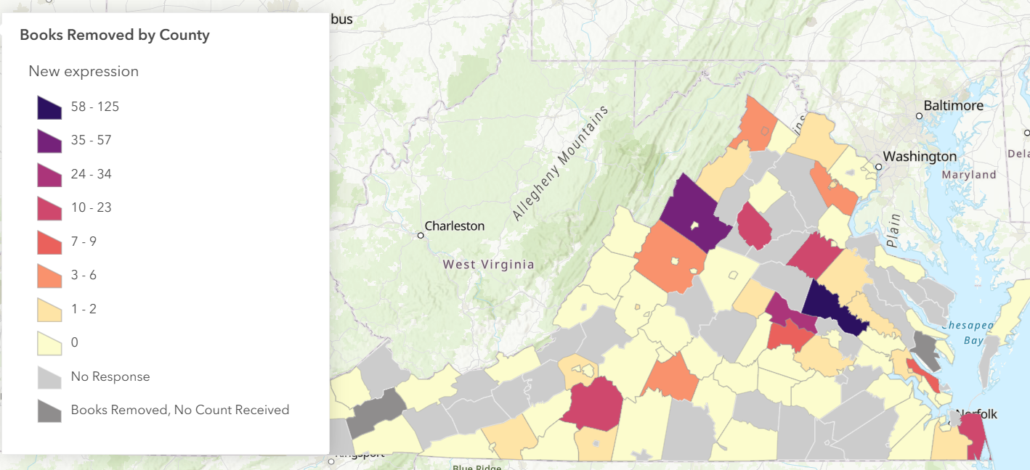
JLARC Findings, 2020-2025

Slide 13
The Normalization of Book Banning?, Cont.
Nationwide: Huge spike in school library book removals 2023-2024; sharp decline in 2024-2025.
ALA reports increasing number of challenges in public libraries, 2023-2025.
Mixed Court Decisions and Proposed Federal Legislation.
Negative Impact on LGBTQ+ authors, publishing.

Slide 14
Conclusions
Censors want schools and libraries to reinforce “community norms,” halt or roll back social changes. Expectations shaped by a constructed regime of racial and sexual norms.
Involvement of nationwide groups, high-level political support relatively new feature.
Concerns over sexual material, foul language in children’s lit generate widest support for censorship.
Emphasis currently on books perceived as challenging gender roles.
Demands of censors tend to grow over time, and are connected to other issues like school budget (may also be true for opposition).
Opposition to censorship a combination of firm stances by individuals, community support, media attention, state or national organizations, like VLA, ALA, ACLU.
.
  Connections between course texts, school libraries, and public libraries
Connections between course texts, school libraries, and public libraries.

Slide 15
Questions?
Keith Weimer, Librarian for History and Religious Studies
University of Virginia
kw6m@virginia.edu

Slide 16
Selected bibliography
Allen, Brittany. “Thanks to the Trump Administration, LGBTQ+ Books Are Getting Harder to Sell.” Literary Hub, January 12, 2026. https://lithub.com/thanks-to-the-trump-administration-lgbtq-books-are-getting-harder-to-sell/ .
“Book Banning’s Evolution: A Look At What’s Coming Next.” School Library Journal 71, no. 12 (2025): 13.
Boyer, Paul S. Purity in Print: Book Censorship in America from the Gilded Age to the Computer Age. Univ of Wisconsin Press, 2002.
Cowan, Paul. “Holy War in West Virginia: A Fight Over America’s Future,” The Village Voice. November 3, 2020. Originally published December 5, 1974. https://www.villagevoice.com/2020/11/03/holy-war-in-west-virginia-a-fight-over-americas-future/. Accessed August 26, 2022.
Cummings, Scott, Richard Briggs, and James Mercy. “Preachers Versus Teachers: Local-Cosmopolitan Conflict over Textbook Censorship in an Appalachian Community.” Rural Sociology 42, no. 1 (Spring 1977): 7–21.
“Federal Bill to Ban LGBTQ Books and Programs in Schools Leans on Old Fears. March 19, 2026.
https://mombian.com/2026/03/19/federal-bill-to-ban-lgbtq-books-and-programs-in-schools-leans-on-old-fears/.
“Gay paper in library stirs fight in Fairfax: ‘Blade’ opponents cite sexual content.” Richmond Times-Dispatch. October 3, 1993.
Goff, Robert Oscar. "The Washington County Schoolbook Controversy: The Political Implications of a Social and Religious Conflict." Ph.d. dissertation. The Catholic University of America. 1977.
Goldwasser, Marion McAdoo. “Censorship: It Happened to Me in Southwest Virginia--It Could Happen to You.” The English Journal 86, no. 2 (1997): 34–42.
Hamlin, Peter Randolph. “A Case Study of the Fairfax County, Virginia, Censorship Controversy, 1963.” Occasional Papers (University of Illinois at Urbana-Champaign. Graduate School of Library Science); No. 95, 1968.

Slide 17
Selected bibliography
Jenkins, Christine A. “Censorship : Book Challenges, Challenging Books, and Young Readers.” In Handbook of Research on Children’s and Young Adult Literature. New York: Routledge, 2011.
Knox, Emily. “‘The Books Will Still Be in the Library’: Narrow Definitions of Censorship in the Discourse of Challengers.”
Library Trends 62, no. 4 (2014): 740–49.
Knox, Emily. Book Banning In 21st-Century America. Lanham, MD: Rowman & Littlefield, 2015.
Knox, Emily. “Society, Institutions, and Common Sense: Themes in the Discourse of Book Challengers in 21st Century United States.”
Library & Information Science Research 36, nos. ¾ (2014): 171–78.
“Library lets parents see children’s records.” Richmond Times-Dispatch. November 12, 1994.
“LOCAL: Norfolk Gays Drop Suit Against City.” Advocate, no. 313 (March 19, 1981): 11.
https://search.ebscohost.com/login.aspx?direct=true&db=qth&AN=10188948&site=ehost-live&scope=site .
McMillan, Laura Smith. “Censorship by Librarians in Public Senior High Schools in Virginia.” Educat.D. dissertation. The College of William and
Mary. 1987.
Minton, Bennett. “The Lies Our Textbooks Told My Generation of Virginians about Slavery.” Washington Post. July 31, 2020.
Moore, Molly. “Behind the Attack on ‘Huck Finn:’ One Angry Educator.” Washington Post. April 21, 1982.
O’Harrow, Robert Jr. “Anti-Gay Crusader on a Roll: Battle With Fairfax Library Launches Darling of the Right.” Washington Post. March 7, 1994.
Packard, Michael. “Banned in the USA: Censorship in Public Libraries in the 1990s.”
Current Studies in Librarianship 23, no. 1/2 (April 15, 1999): 61–67.
“Parents Calling for Resignations.” Richmond Times-Dispatch. April 11, 1974.
PEN America. “The Normalization of Book Banning.” October 1, 2025. https://pen.org/report/the-normalization-of-book-banning/ .
Pettys, Todd E. “Serious Value, Prurient Appeal, and ‘Obscene’ Books in the Hands of Children.” William & Mary Bill of Rights Journal 31, no. 4
(2023), https://scholarship.law.wm.edu/wmborj/vol31/iss4/2 .

Slide 18
Selected bibliography
“Special to The New,York Times. Virginia library fights for books that a minister labels 'obscene': Book sellers were fined suit over book
ban.” New York Times. December 14, 1980.
“State of America’s Libraries: A Snapshot [2023 through 2025]|ALA.” Accessed April 30, 2026.
https://www.ala.org/news/state-americas-libraries-report- [enter 2023, 2024, or 2025].
Sullivan, Caitlin. “Book Flap Brings Back Memories -- Challenge 27 Years Ago Attracted National Attention.” SWVA Today, January 12, 2022.|
https://swvatoday.com/news/article_84205505-ddb6- 5886-97d9-bd32e4e1da6a.html. Originally published, September 26, 2007.
"VB Mayor McCoy: Politics, Religion, and the Public Library." Our Own Community Press 5, no. 2 (1980): 4. Archives of Sexuality and Gender (accessed August 26, 2022). https://link-gale-com.proxy01.its.virginia.edu/apps/doc/JZRISW600064618/AHSI?u=viva_uva&sid=bookmark-AHSI&xid=c31ac9bc.
“VLA Intellectual Freedom Update February 1, 2017.” Accessed April 5, 2022. https://www.vla.org/vla-intellectual-freedom-update-february-1--2017.
“Vote Ousts Gay Paper In Va. Beach Library.” Washington Post. November 6, 1980.
Vozzella, Laura, and Gregory S. Schneider. “Fight over Teaching ‘Beloved’ Book in Schools Becomes Hot Topic in Virginia Governor’s Race.” Washington Post. October 25, 2021.
Walsh, Mark. “Yanking Books from School libraries: What the Supreme Court Has Said and why It’s Murky,” Education Week, December 15, 2021. https://www.edweek.org/policy-politics/yanking-books-from-school-libraries-what-the-supreme-court-has-said-and-why-its-murky/2021/12 .
Wiegand, Wayne A.. American Public School Librarianship: A History. Baltimore: Johns Hopkins University Press, 2021.
Wiegand, Wayne A. and Shirley A. Wiegand. The Desegregation of Public Libraries In the Jim Crow South: Civil Rights and Local Activism.
Baton Rouge: Louisiana State University Press, 2018.
Wiegand, Wayne A. and Ebook Central - Academic Complete. Part of Our Lives: A People's History of the American Public Library.
Oxford: Oxford University Press, 2015.
Yorio, Kara. 2025. Behind the numbers: Fewer challenges, but book banning remains in full force. School Library Journal 71, 5 (2025).

